Slide 1
Navigating Success: Harnessing Academic Data for Student Outcome Projections
Team Members: Isha Mahadalkar, Shashank Thandri, Fan Yang
CNIT 62300
Notes:
Shashank
Introduce topic and team members

Slide 2
TABLE OF CONTENTS
01
02
03
04
05
06
Introduction
Previous research
Methodology
Discussion and Results
Limitation and Future Work
Conclusion
Notes:
Shashank
Introduce what we are going to cover today

Slide 3
01
Introduction
Notes:
Shashank

Slide 4
BACKGROUND
Enabling the prediction of students' academic performance allows teachers to identify and address challenges at an earlier stage than previously possible. This early intervention can make a substantial difference in a student's educational journey.
Predictive analytics can enable timely support for at-risk students (Lourens & Bleazard, 2016)
Comprehensive Approach：
Integrate the features that affect student performance to create more accurate predictive models
Notes:
Shashank
In the proposal we talked about how important it is for early intervention when it comes to teaching
Lots of time students can have their performances improved if there is early intervention from the faculty and from the teachers
This allows teachers to address challenges at an earlier stage to prevent students from failing or dropping out down the line
Predictive analytics can provide teachers with a look into the future and see which students are at most risk of struggling or failing in school
There are many features that can exist when looking at what students are at risk and it is important to understand which features provide the most accurate predictive model

Slide 5
02
Previous Research
Notes:
Shashank
Now that we have covered a little bit of the background of the issue we want to talk about a little literature that we studied to help us understand the research gap
We talked about this literature before but we want to cover it briefly again as it will help in understanding what we want to do with our study

Slide 6
Previous Work
1
Aggarwal, D., Mittal, S., & Bali, V. (2021). Significance of non-academic parameters for predicting student performance using ensemble learning techniques. International Journal of System Dynamics Applications (IJSDA), 10(3), 38-49.
Result: Two experiments were conducted. The first used only academic parameters, while the second utilized all parameters (academic and non-academic). The F1-Score was employed to evaluate model performance. The F1-Score significantly improved when using all parameters (79.6% vs. 93.8%). Notably, Logistic Regression, Multilayer Perceptron, and Voting meta classifiers demonstrated promising results.
2
Yağcı, M. (2022). Educational data mining: prediction of students' academic performance using machine learning algorithms. Smart Learning Environments, 9(1), 11.
Result: Model performance was evaluated using multiple metrics, including the confusion matrix, classification accuracy (CA), precision, recall, F1-score, and the area under the ROC curve (AUC). The results revealed that Random Forest (RF), Neural Network (NN), and Support Vector Machine (SVM) algorithms demonstrated the highest classification accuracy, the proposed model achieved a classification accuracy of 70-75% (AUC).
Notes:
Shashank
Study 1: Covered the difference in making predicitve models using academic vs non-academic parameters
We can clearly see the lack of accuracy when using non-academic parameters vs when using academic parameters at 79.6 vs 93.8 percent
They used a wide range of classifiers including DT, LR,Multilayer perceptron, and Voting meta classifiers; with the last 3 providing the best results
Study 2: Once again looked to predict the outcome of students based on non-academic parameters
Used RF, NN, and SVM to make predictions and was only able to achieve a classification accuracy of about 72% on average

Slide 7
Previous Work
Martins, M. V., Tolledo, D., Machado, J., Baptista, L. M., & Realinho, V. (2021). Early Prediction of Student’s Performance in Higher Education: A Case Study. In Trends and Applications in Information Systems and Technologies: Volume 1 9 (pp. 166-175). Springer International Publishing.
3
Result: Similar to other works this paper attempts to predict student performance in higher education using non-academic information. Using XG boosting and other forms of boosting they got an average of 73% accuracy when not using academic information
Our dataset that we used came from this study
Notes:
Shashank
Study3: This study , where we got our dataset from, attempted to predict the performance of students in higher education only using non-academic data
They had access to their first year grades and have the data yet did not attempt to make predictions using this data
They only wanted to focus on the non-academic data
Using XG boosting and various other boosting methods they came to an average of about 73% accuracy based on their features they chose

Slide 8
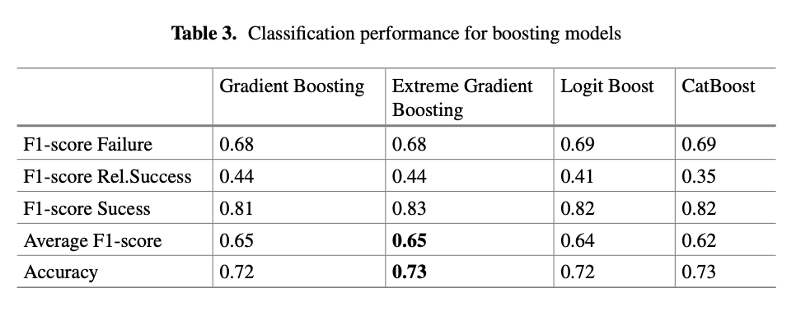
Previous Work
Martins, M. V., Tolledo, D., Machado, J., Baptista, L. M., & Realinho, V. (2021). Early Prediction of Student’s Performance in Higher Education: A Case Study. In Trends and Applications in Information Systems and Technologies: Volume 1 9 (pp. 166-175). Springer International Publishing.

Slide 9
Research Gap
A notable research gap exists in the examination of the predictive power of first-year grades in forecasting
Despite the recognize importance of first-year academic performance, few studies have systematically explored its role as a predictor, leaving a significant void in our understanding of the comprehensive factors influencing student success
This study aims to fill this critical gap by investigating the predictive value of first-year grades and their potential impact on the targeted outcome
Notes:
Shashank
Based on some of the literature we studied and presented, we can see that a notable gap exists in the examination of the predictive power of first year grades in forecasting
Using academic performance as a predictor is universally recognized as important, not just within the Machine learning world, but also the education world in general
However, few studies have systematically explored its role as a predictor which has left a significant void in our understanding of the comprehensive factors influencing student success
Our study aims to fill the critical gap by investigating the predictive value of first year grades and their potential impact on the targeted outcome
For our final project, we wanted to implement a portion of what we mentioned above, with three main points
The existing body of literature on academic performance prediction has primarily focused on [specific aspects covered in previous studies, e.g., demographics, test scores, etc.]. However, a notable research gap exists in the examination of the predictive power of first-year grades in forecasting [the specific outcome you are interested in, e.g., overall academic success, graduation rates, etc.]. Despite the recognized importance of first-year academic performance, few studies have systematically explored its role as a predictor, leaving a significant void in our understanding of the comprehensive factors influencing student success. This research aims to fill this critical gap by investigating the predictive value of first-year grades and their potential impact on [the targeted outcome], thereby contributing valuable insights to the field of academic performance prediction."
Research Gap: Based on the previous work in this field, we want to see the importance of first year grades being used in predicting the performance outcome for students in a four year college program
How the first-year grades affect the academic performance,
And aiming for a better performance

Slide 10
PROBLEM STATEMENT
In the below study on predicting student performance, various models were employed to classify student academic outcomes effectively. However, the study lacked an analysis of key parameters influencing academic success. Furthermore, it only considered pre-enrollment data, overlooking first-semester performance post-enrollment, which is also likely significant for academic results.
Martins, M. V., Tolledo, D., Machado, J., Baptista, L. M., & Realinho, V. (2021). Early Prediction of Student’s Performance in Higher Education: A Case Study. In Trends and Applications in Information Systems and Technologies: Volume 1 9 (pp. 166-175). Springer International Publishing.
Notes:
Fan
For our final project, we wanted to implement a portion of what we mentioned above, with three main points

Slide 11
RESEARCH QUESTION
What are the most effective features and factors in predicting a student's academic performance?
Does performance during the first year of enrollment affects a student's final academic outcome?
Notes:
Shashank
The two research questions we will work to solve are
What are the most effective features and factors in predicting a student's academic performance?
Does performance during the first year of enrollment affects a student's final academic outcome?

Slide 12
03
METHODOLOGY
Notes:
Shashank (Transition) (I will pass this to isha ahhhh behavior)
Baseline model LR: no scaling, no model tuning work, baseline based off the paper, accuracy: 65.8%
F1 scores are trash
Predicting drop out 0.66 F1 score

Slide 13
METHODOLOGY
Data Sourcing
Data Preprocessing
Exploratory Data Analysis (EDA)
Baseline Modeling
01
02
03
04
05
06
07
08
Feature Importance
Advanced Modeling
Hyperparameter Tuning
Model Evaluation
Notes:
Data: We started with collecting relevant data, we wanted data that included features such as demographic information as well as academic performance since we wanted to predict at risk students keeping their first year grades into account.
We looked at 3 different datasets before settling on the one which we chose which included this information.
Then we did some prelimnary analysis on the data to understand its structure, identify missing values, and gain insights into the distribution of features.

Slide 14
Data
1.
Polytechnic Institute of Portalegre, Portugal
2.
4424 records and 37 independent variables.
3.
Demographic, socio-economic, and academic path factors are included.
Age, Gender, Marital Status
Parents Qualifications, Loans, Scholarships
First year curriculum and grades
4.
Target Variable
Graduate, Enrolled, Dropout
Classifications represent 'low-risk,' 'medium-risk,' and 'high-risk' students.
First year curriculum and grades
Notes:
Our dataset covers a substantial period, ranging from the academic year 2008/09 to 2018/2019. It comprises records from various undergraduate degrees, providing a rich and diverse source of information
The dataset encompasses a wide array of variables, including demographic factors like age, gender, and marital status. Additionally, socio-economic factors such as parent's qualifications.
A significant focus is placed on academic path factors, including admission grade, retention years at high school, and the order of choice for the enrolled course. These factors contribute to understanding student trajectories.
Each record in our study is classified into one of three categories: Graduate, Enrolled and Dropout. This classification is determined by the time taken by students to obtain their degree.
low-risk' for high probability of success, 'medium-risk' indicating potential success with institutional support, and 'high-risk' for those at risk of failure.

Slide 15
Data Preprocessing
1.
Handling Missing Data
Null Values
Duplicate Rows
2.
Rename Columns
3.
Encoding Categorical Variables
There are 3 unique values in target column:
Graduate - 0
Enrolled – 1
Dropout – 2
Other Categorical Variables
One Hot Encoding
4.
Scaling Numerical Variables

Slide 16
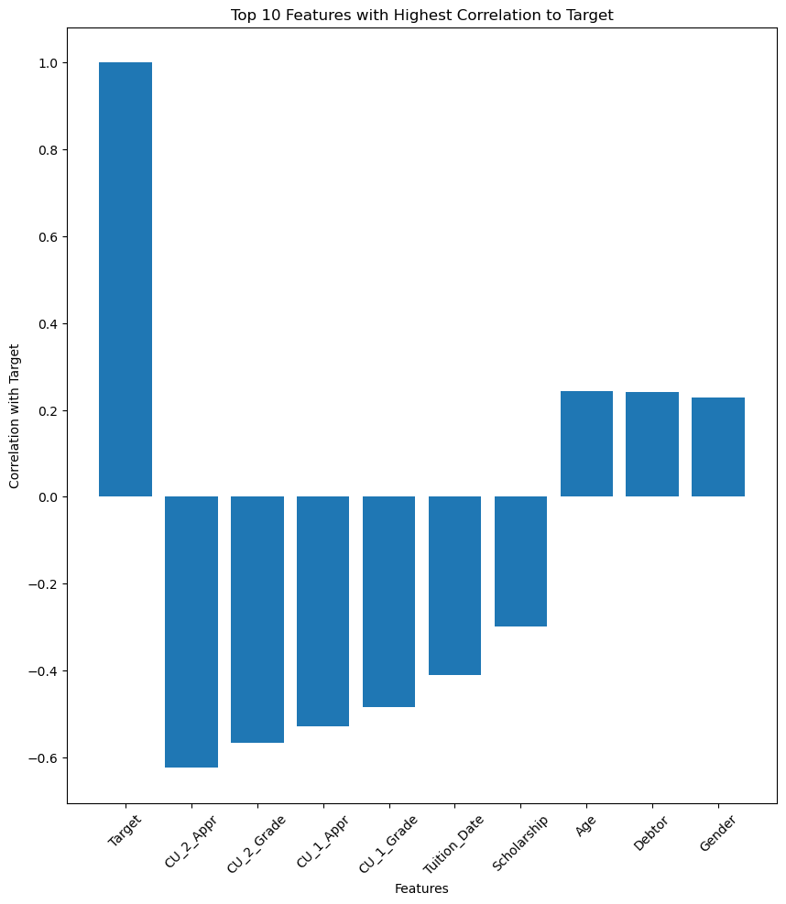
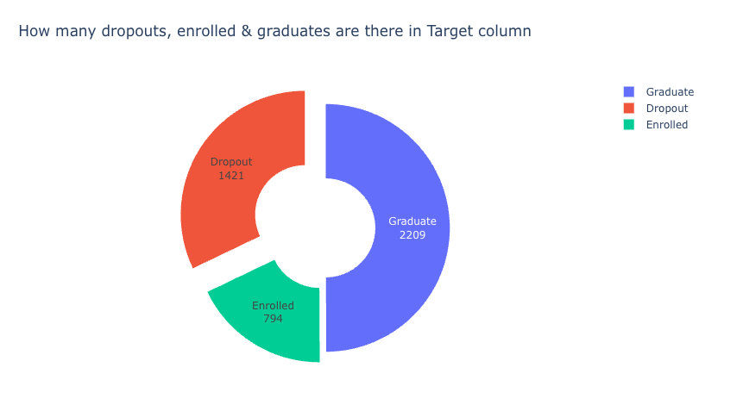
Exploratory Data Analysis
1.
Feature Correlation
First Year Curriculum Data is highly important
2.
Target Variable
Unbalanced Classes
Notes:
Explore the dataset to understand its structure, identify missing values, and gain insights into the distribution of features.
Summary statistics, information about the dataset, visualizing the distribution of the target variable, visualizing correlations between numerical features, and visualizing the distribution of numerical and categorical features.

Slide 17
Baseline Modelling
1.
Splitting the data
Training set size: 3539 (80%)
Testing set size: 221 (5%)
Validation set size: 222 (5%)
Holdout set size: 442 (10%)
2.
Logistic Regression (Martins et al., 2021)
Accuracy: 0.68​
Avg. F1 Score: 0.49​
3.
Logistic Regression w/ curriculum data
For our analysis, we include the first and second semester curriculum data since we want to test early intervention.

Slide 18
Building our Model
1.
Handling Class Imbalance
SMOTE: 1791 data points for each Target class.
2.
Feature Selection
Manually select 3-4 features.
Considering relevance to the problem, correlation with the target variable, and domain knowledge.
Repeat
3.
Drop 8-10 features
Limit to the most relevant features that are likely to contribute to the predictive performance.
Notes:
But, there is a class imbalance which we will have to take into account. Since, we would like to predict the Dropout class with a higher accuracy we will need to fix the class imbalance to get true results.

Slide 19
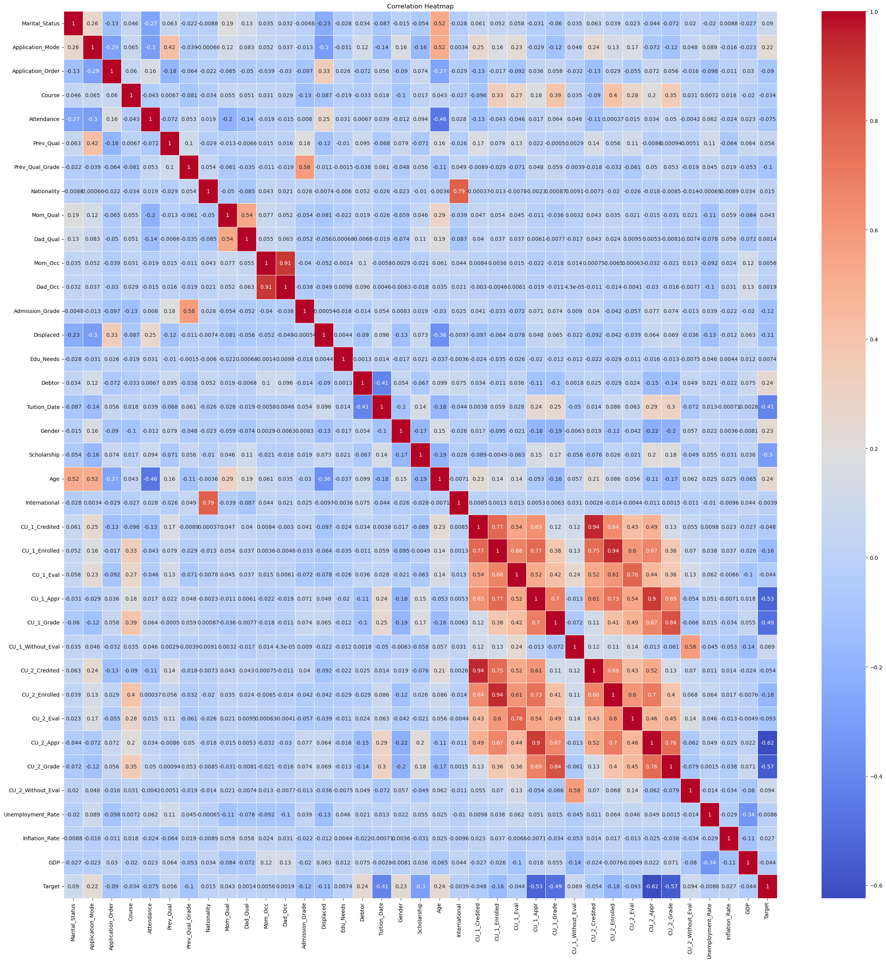
Correlation Matrix
Columns with absolute correlation lower than 0.05 with the target variable:
['Course', 'Nationality', 'Mom_Qual', 'Dad_Qual', 'Mom_Occ', 'Dad_Occ',
'Edu_Needs', 'International', 'CU_1_Credited', 'CU_1_Eval',
'Unemployment_Rate', 'Inflation_Rate', 'GDP']
We will still keep the "CU_*" columns since we want the first year grade information.

Slide 20
Model Pipeline
Model
Preprocessor (ColumnTransformer)
One Hot Encoder
Classifier
Fit (Training Data)
Standard Scalar
Predict (Testing Data)
Evaluate
List of Classifiers:
DecisionTreeClassifier
RandomForestClassifier
LogisticRegression
KNeighborsClassifier
AdaBoostClassifier
XGBClassifier
SVC
Notes:
Feature Engineering: Scaling, and Standardization
These techniques can help to improve model performance, reduce the impact of outliers, and ensure that the data is on the same scale.
It is a good practice to fit the scaler on the training data and then use it to transform the testing data. This would avoid any data leakage during the model testing process. Also, the scaling of target values is generally not required.
We tested these list of classifiers using this model to check which ones were the best performing.

Slide 21
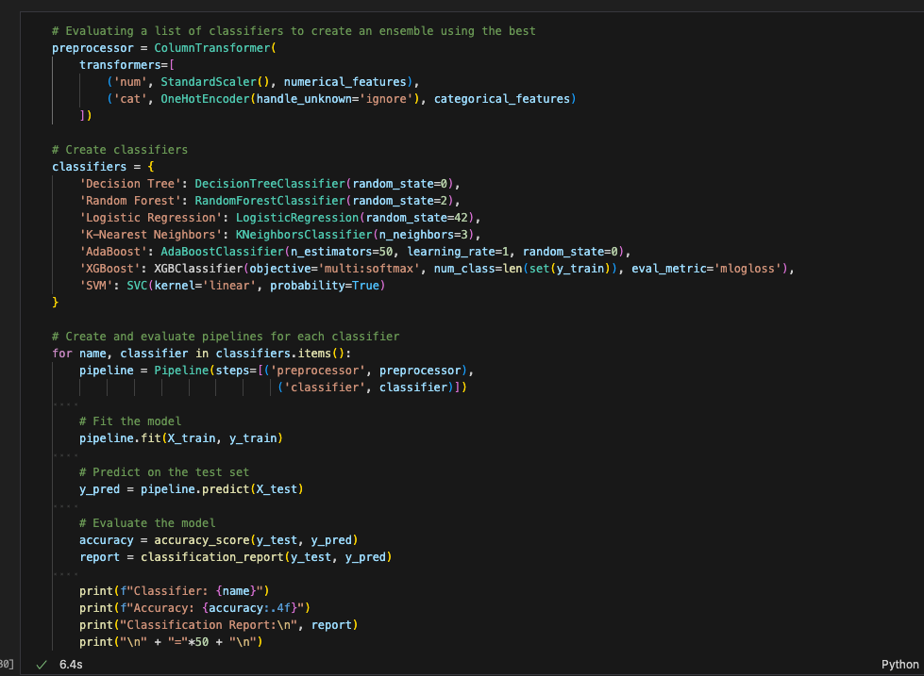
Code

Slide 22
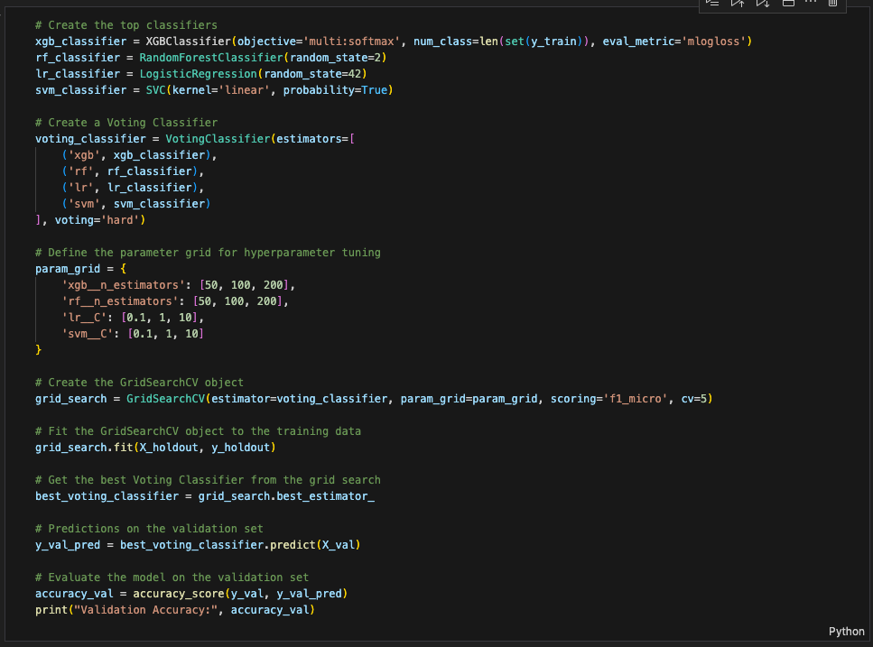
Hyperparameter Tuning
We use GridSearch to test multiple configurations and picking the one that performs better with cross-validation
CV = 5
F1 Score is maximized
We use the holdout set to optimize the training on a small subset of the data and validation set to test for an unbiased evaluation of the model's generalization performance.

Slide 23
Ensemble
Ensemble
One Hot Encoder
Voting Classifier
Base Estimators
Standard Scalar
Predict (Testing Data)
Evaluate
Preprocessor (ColumnTransformer)
List of Estimators:
RandomForestClassifier
LogisticRegression
XGBClassifier
SVC
Hard and Soft Voting
Notes:
Feature Engineering: Scaling, and Standardization
These techniques can help to improve model performance, reduce the impact of outliers, and ensure that the data is on the same scale.
It is a good practice to fit the scaler on the training data and then use it to transform the testing data. This would avoid any data leakage during the model testing process. Also, the scaling of target values is generally not required.
We tested these list of classifiers using this model to check which ones were the best performing.

Slide 24
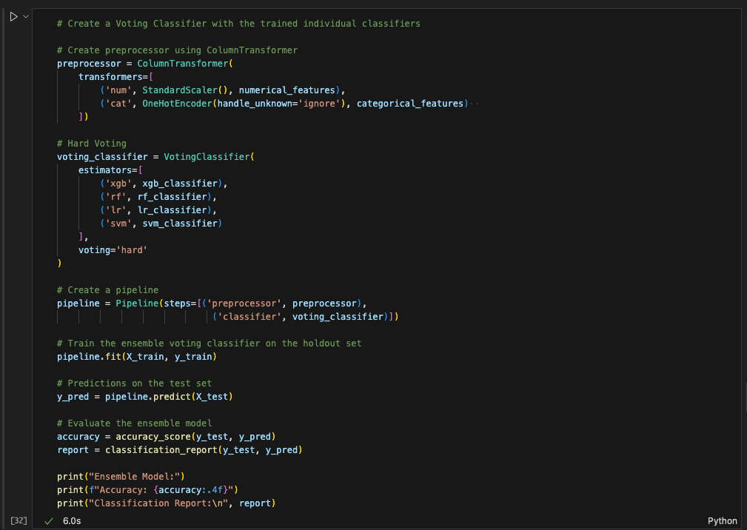
Code

Slide 25
04
Results
Notes:
Shashank

Slide 26
Baseline Classification Performance
 | Accuracy | Avg F1 Score | F1 Score (Dropout)
Logistic Regression (Martins et al., 2021) | 0.68 | 0.49 | 0.61
XGBoost (Martins et al., 2021) | 0.73 | 0.65 | 0.68
Logistic Regression w/ curriculum data (Baseline) | 0.74 | 0.71 | 0.75

Slide 27
Model Classification Performance
 | Accuracy | Avg F1 Score | F1 Score (Dropout)
Decision Tree | 0.71 | 0.67 | 0.72
Random Forest | 0.75 | 0.71 | 0.77
Logistic Regression | 0.74 | 0.71 | 0.75
K-Nearest Neighbors | 0.69 | 0.65 | 0.63
Adaboost | 0.71 | 0.67 | 0.71
XGBoost | 0.75 | 0.71 | 0.74
SVM | 0.73 | 0.70 | 0.73

Slide 28
Classification Performance for Ensemble Models
 | Accuracy | Avg F1 Score | F1 Score (Dropout)
Hard Voting | 0.76 | 0.72 | 0.76
Soft Voting | 0.77 | 0.73 | 0.76
Final Model Results:
Accuracy: 77% > 74%
F1 Score (Dropout): 0.76 > 0.75
Notes:
The top 4 classifiers were: XGBoost, Random Forest, Logistic Regression and SVM
# We will use these to create the ensemble

Slide 29
05
Limitations and Future work
Notes:
Shashank

Slide 30
Limitations
01
02
03
Data size and Generalization
Assumption of Independence
Temporal Dynamics
Notes:
Data Size and Generalization:
The study is based on a specific dataset, and the generalization of findings to broader populations may be limited.
A larger and more diverse dataset could enhance the model's ability to generalize to different contexts.
Assumption of Independence:
Models may assume independence between features, which might not hold in real-world scenarios.
Investigating and addressing potential dependencies among features could enhance model accuracy.
Temporal Dynamics:
The study may not capture temporal dynamics in student performance.
Future research could explore time-series models to account for trends or changes in academic performance over time.

Slide 31
Future Work
01
02
03
Deep Learning Architectures
Explainability and Interpretability
Transferability to other education settings
Notes:
Deep Learning Architectures:
Explore the application of deep learning architectures, such as neural networks, to capture complex relationships within the data.
Explanbility and Interpretability:
Develop methods for enhancing the interpretability of the models to provide more transparent insights into the factors influencing predictions.
Transferability to Other Educational Settings:
Assess the transferability of the developed models to different educational settings or institutions to enhance the applicability of the findings.

Slide 32
06
Conclusion
Notes:
Fan

Slide 33
Conclusion
Based on our study we can confirm the importance of academic data when it comes to predicting the outcome of students in higher education.
We specifically looked at the first year academic data and can see the accuracy of predicting the outcome of students.
While there is still a lot of work that can be completed in this specific field of education, our study adds to the literature on how important it is to have a strong first year academic performance to set yourself up for success.

Slide 34
References
Aggarwal, D., Mittal, S., & Bali, V. (2021). Significance of non-academic parameters for predicting student performance using ensemble learning techniques. International Journal of System Dynamics Applications (IJSDA), 10(3), 38-49.
Asif, R., Merceron, A., & Pathan, M. K. (2014). Predicting student academic performance at degree Level: A case study. International Journal of Intelligent Systems and Applications, 7(1), 49–61. https://doi.org/10.5815/ijisa.2015.01.05
Jiménez-Castellanos, Ó. (2010). Relationship between educational resources and school achievement: A Mixed Method Intra-District Analysis. The Urban Review, 42(4), 351–371. https://doi.org/10.1007/s11256-010-0166-6
Li, K., Rusk, D., & Song, F. (2013, July 1). Predicting student academic performance. IEEE Conference Publication | IEEE Xplore. https://ieeexplore.ieee.org/abstract/document/6603862?casa_token=jPQPTYI1NQwAAAAA:Vf_nndQFSLgQ1lKoKUfpEktyGXtPDDEpXwPcP8oZnKtKmTNo7cx76rdsD1p8Jop4DkySvo2X2w
López, M. B., Alor-Hernández, G., Sánchez-Cervantes, J. L., Paredes-Valverde, M. A., & Del Pilar Salas-Zárate, M. (2020). EduReComSYS: An educational resource recommender system based on collaborative filtering and emotion detection. Interacting With Computers, 32(4), 407–432. https://doi.org/10.1093/iwc/iwab001

Slide 35
References
Lourens, A., & Bleazard, D. (2016). Applying predictive analytics in identifying students at risk: A case study. South African Journal of Higher Education, 30(2). https://doi.org/10.20853/30-2-583
Raudenbush, S. W., Fotiu, R. P., & Cheong, Y. F. (1998). Inequality of Access to Educational Resources: A National Report Card for Eighth-Grade math. Educational Evaluation and Policy Analysis, 20(4), 253–267. https://doi.org/10.3102/01623737020004253
Starkey, L. (2019). A review of research exploring teacher preparation for the digital age. Cambridge Journal of Education, 50(1), 37–56. https://doi.org/10.1080/0305764x.2019.1625867
Twining, P., Raffaghelli, J. E., Albion, P., & Knezek, D. (2013). Moving education into the digital age: the contribution of teachers’ professional development. Journal of Computer Assisted Learning, 29(5), 426–437. https://doi.org/10.1111/jcal.12031
Yağcı, M. (2022). Educational data mining: prediction of students' academic performance using machine learning algorithms. Smart Learning Environments, 9(1), 11.
Zhang, L., Basham, J. D., & Yang, S. (2020). Understanding the implementation of personalized learning: A research synthesis. Educational Research Review, 31, 100339. https://doi.org/10.1016/j.edurev.2020.100339

Slide 36
Thank you!
Questions?

